Slide 1

HEALTHCARE PORTAL
Sudhanshu Kulkarni, Vedika Shenoy

Slide 2
PROJECT GOALS
To create a well organized database for Healthcare Portal.
To create a common interface for all the users of the portal such as Patients, Doctors and Receptionists.
To ensure automation by offering features such as online appointment booking, medical diagnosis by doctors and subsequent bill generation.

Slide 3
BUSINESS RULES
A patient must book an appointment before entering the healthcare center and it can only be done using the healthcare portal.
Doctors cannot cancel an appointment once they are assigned to it.
Doctors can access all the patient data whenever they need it.
A patient can undergo one medical exam only once in a day.
Patient must show up 15 minutes before the appointment.
A doctor can attend multiple appointments, but one appointment must be attended by only one doctor.
A patient can book only one doctor for one appointment.

Slide 4
BUSINESS RULES
A user of the healthcare portal must either be a patient, doctor or a receptionist.
One appointment can have only one bill.
One appointment can consist of more than one diagnosis, but one diagnosis is pertained to one appointment.
Only one type of insurance is provided to patients who opt for it.
One Diagnosis (entity name) can be determined by one medical exam, but one type of medical exam can make one or more Diagnosis.
One bill can consist of one or more Diagnosis (entity name), but one Diagnosis will be written in one bill.
One bill can consist of one or more medical exams and one type of medical exam can be included in many bills.
Insurance is provided by only one company to all the patients.

Slide 5
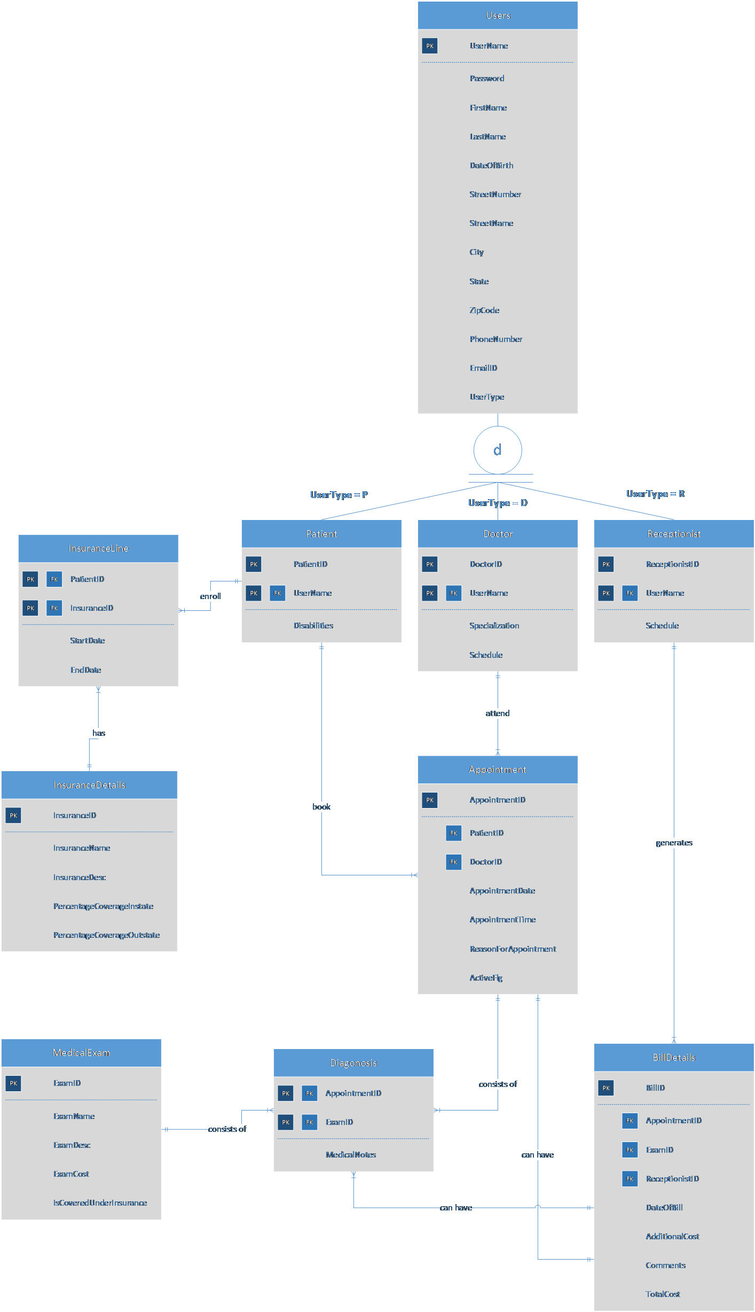
ENTITY RELATIONSHIP DIAGRAM

Slide 6
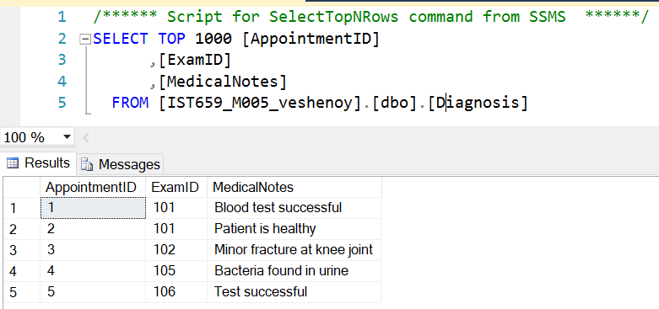
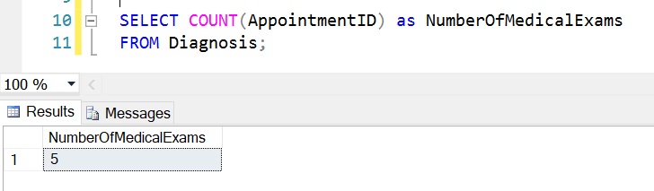
MAJOR DATA QUESTIONS
How many medical examinations are being conducted at the healthcare organization?
Database:
Query:

Slide 7
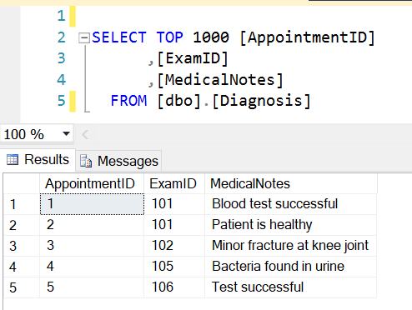
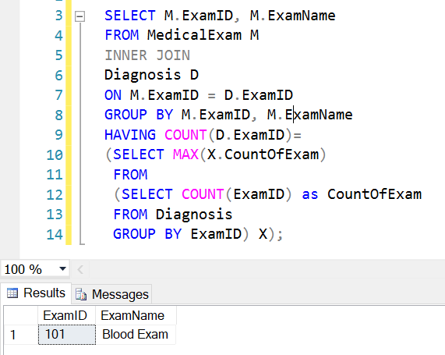
MAJOR DATA QUESTIONS
Which type of medical examination is being carried out most frequently?
Database:
Query:

Slide 8
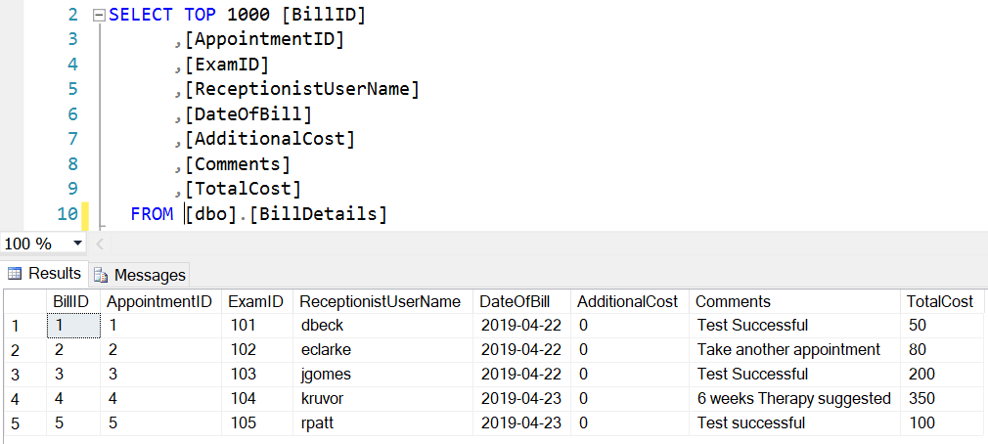
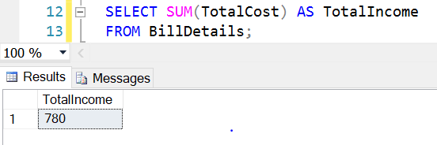
MAJOR DATA QUESTIONS
How much is the income of the healthcare organization?
Database:
Query:

Slide 9
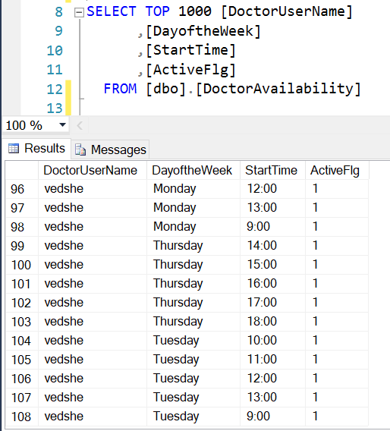
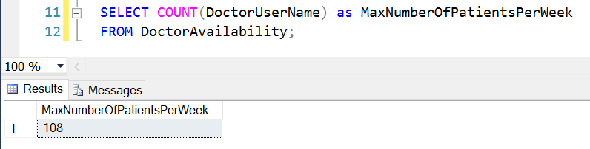
MAJOR DATA QUESTIONS
What is the maximum number of patients that can be admitted in the healthcare organization?
Database:
Query:

Slide 10
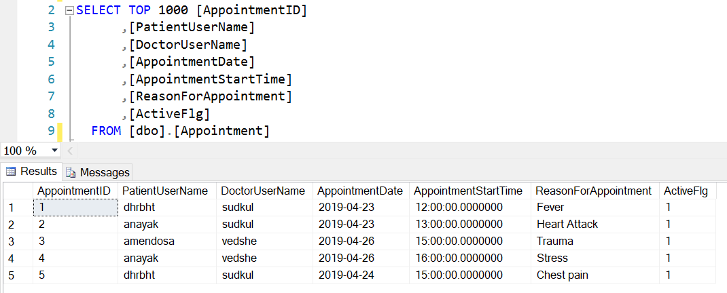
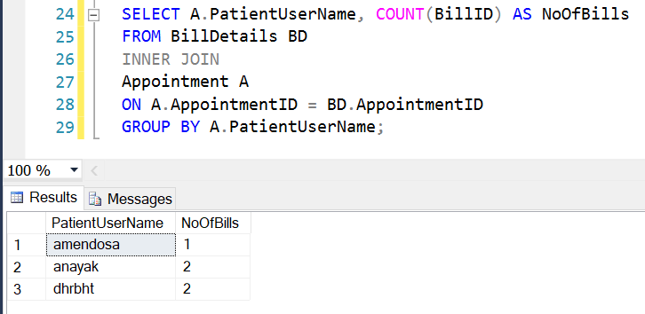
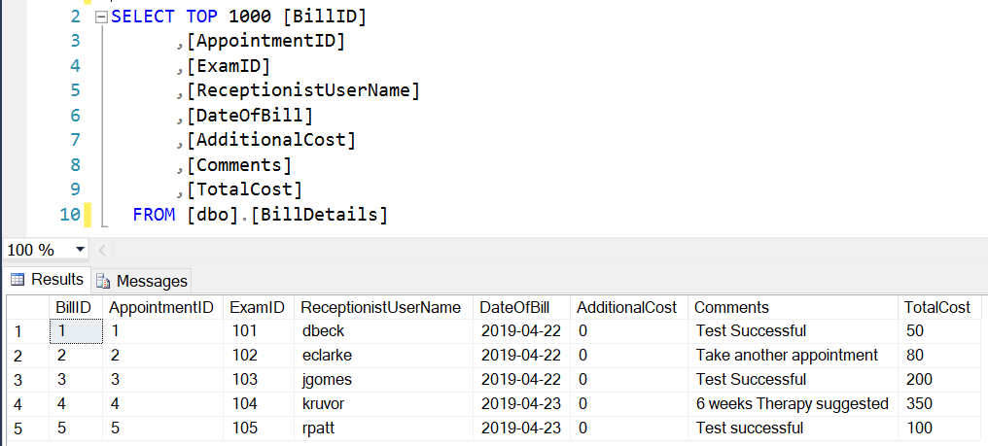
MAJOR DATA QUESTIONS
Appointment Database:
How many bills are being generated by a patient?
Query:
Bill Details Database:

Slide 11
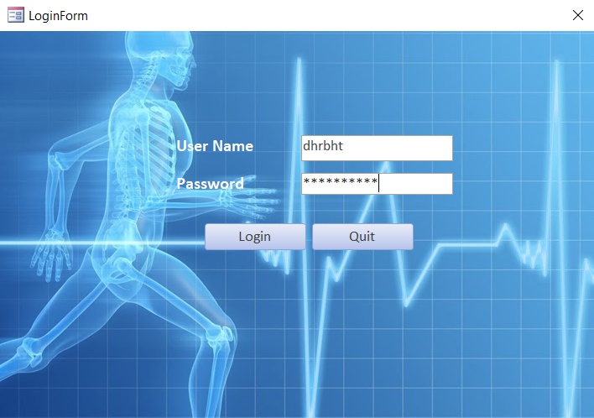
LOGIN FORM

Slide 12
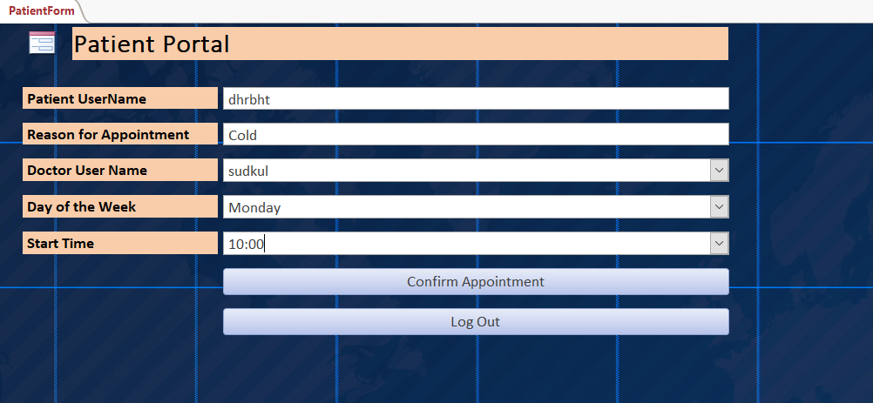
PATIENT FORM

Slide 13
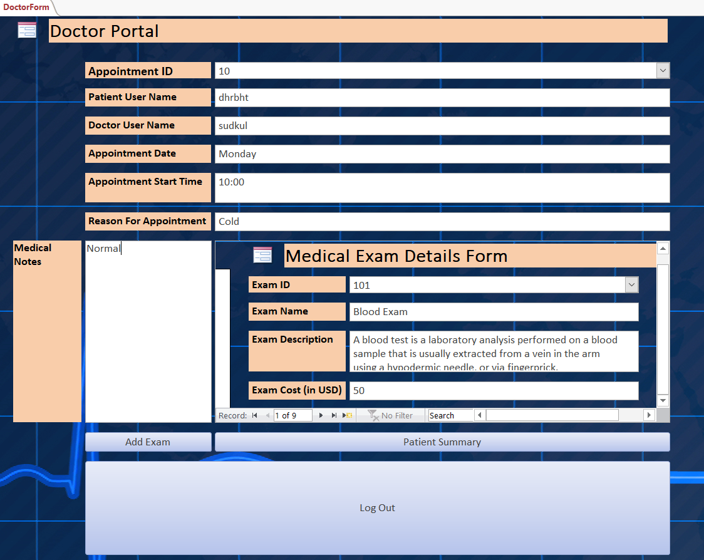
DOCTOR FORM

Slide 14
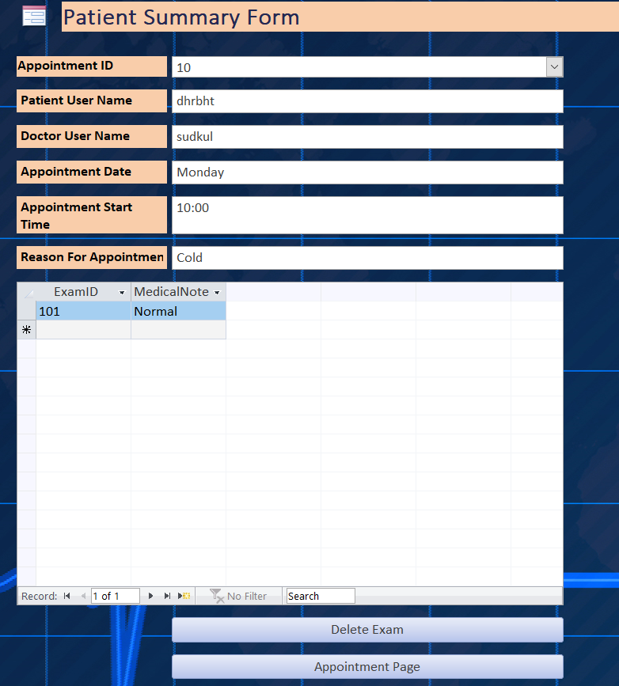
PATIENT SUMMARY FORM

Slide 15
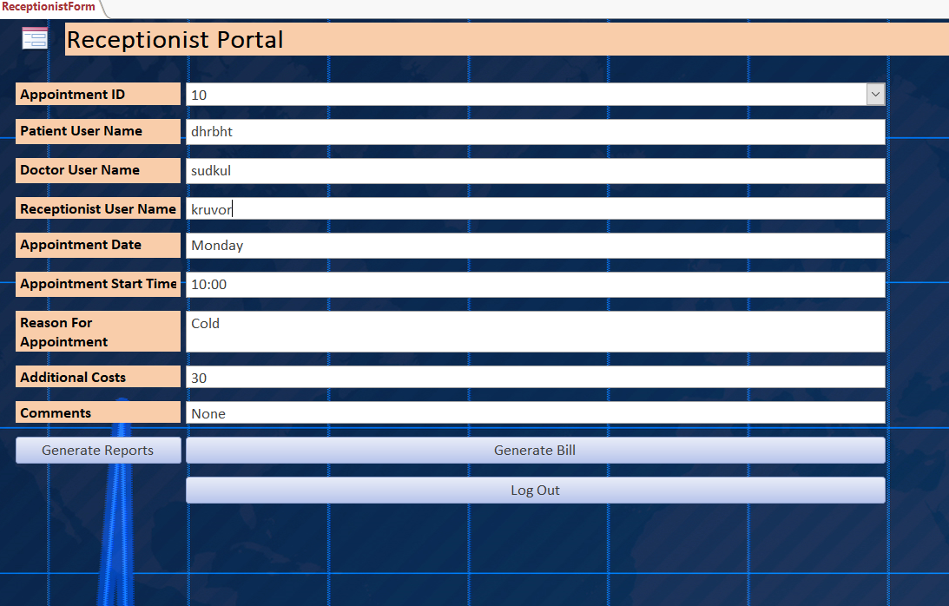
RECEPTIONIST FORM

Slide 16
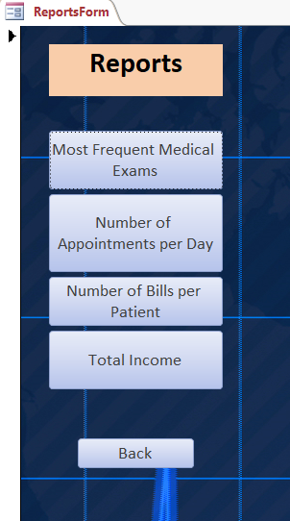
REPORT GENERATION FORM

Slide 17
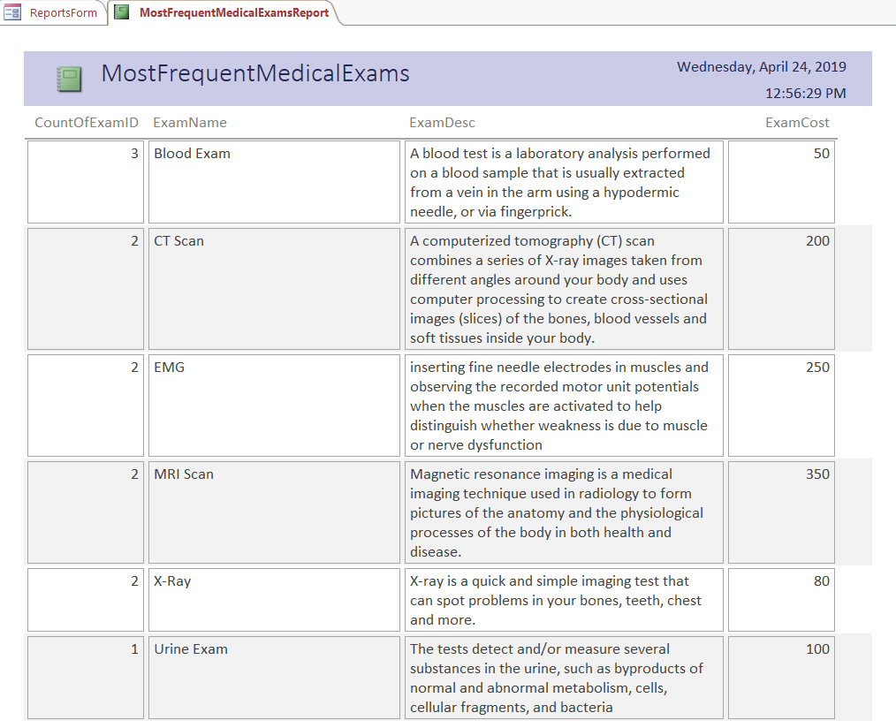
MOST FREQUENT MEDICAL EXAM REPORT

Slide 18
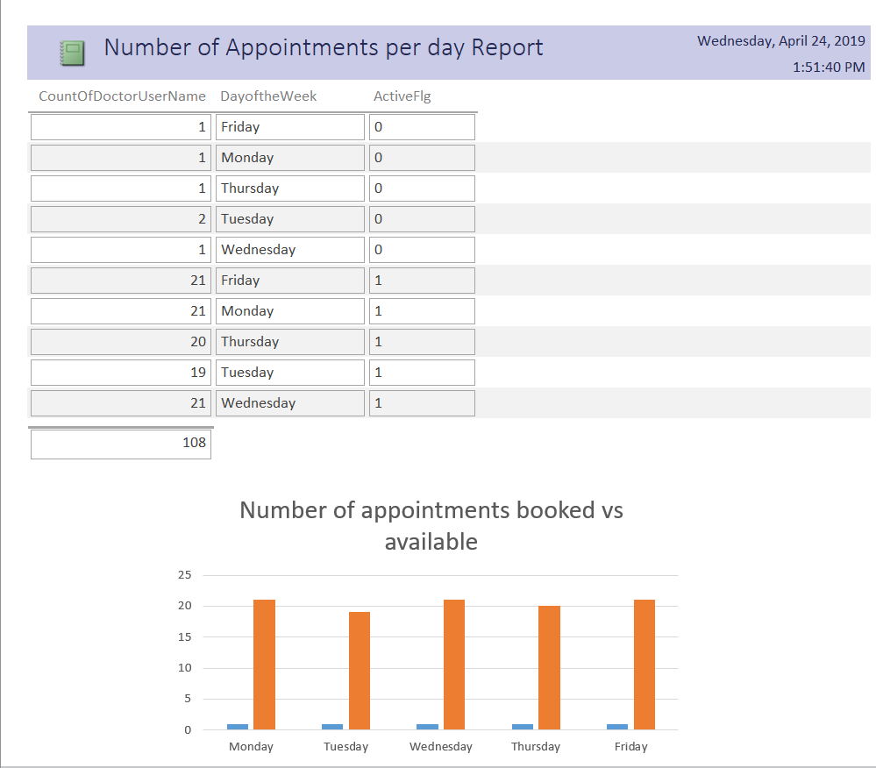
APPOINTMENTS PER DAY REPORT

Slide 19
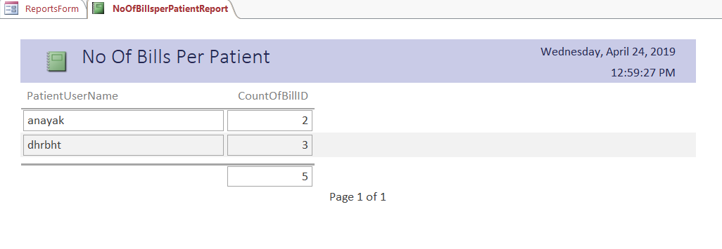
BILLS GENERATED PER PATIENT REPORT

Slide 20
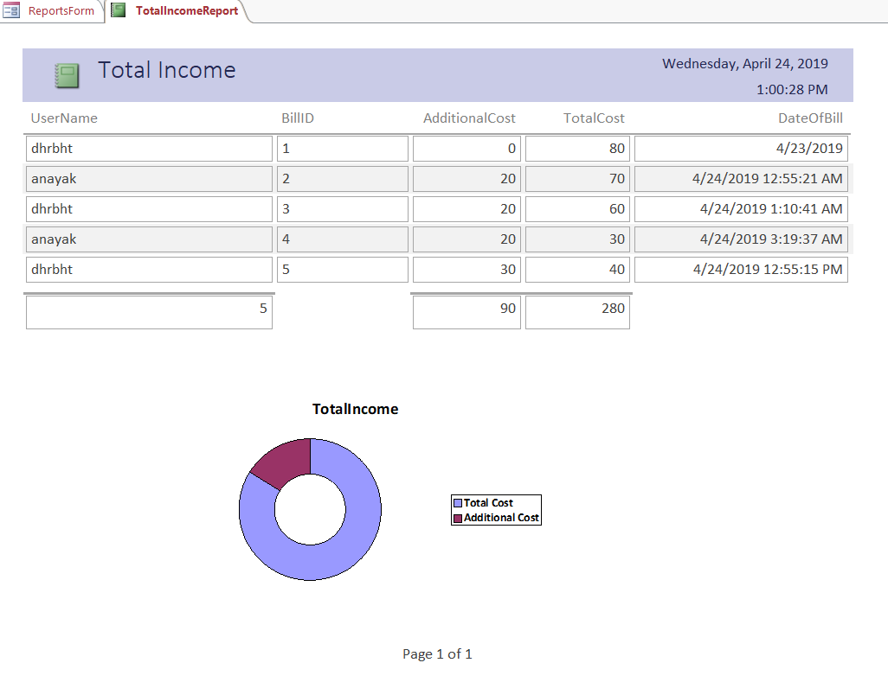
TOTAL INCOME REPORT

Slide 21
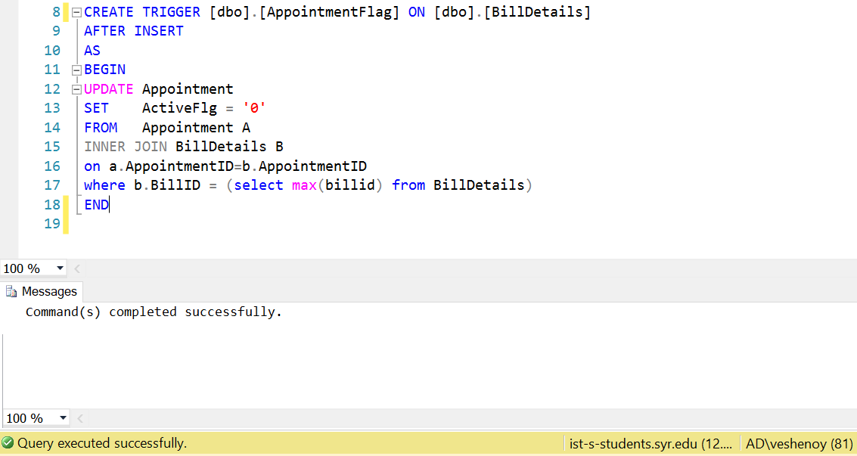
TRIGGER
After Insert Trigger for Patient appointment upon Bill Generation

Slide 22
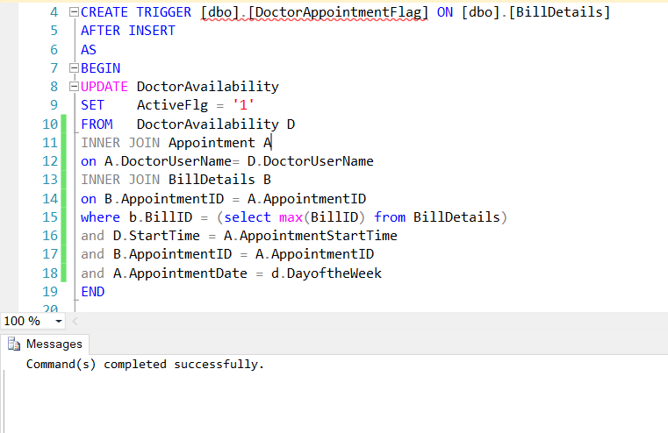
TRIGGER
After Insert Trigger for Doctor Availability upon Bill Generation

Slide 23
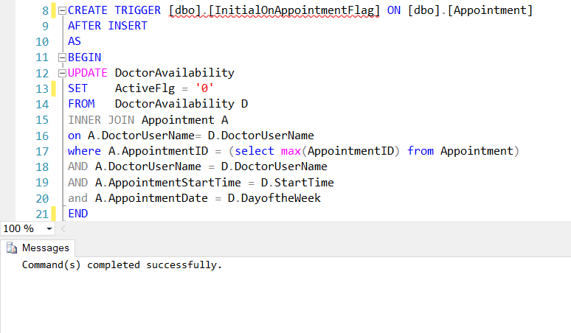
TRIGGER
After Insert Trigger for Doctor Availability upon Appointment

Slide 24
THANK YOU
ANY QUESTIONS ?

